Slide 1





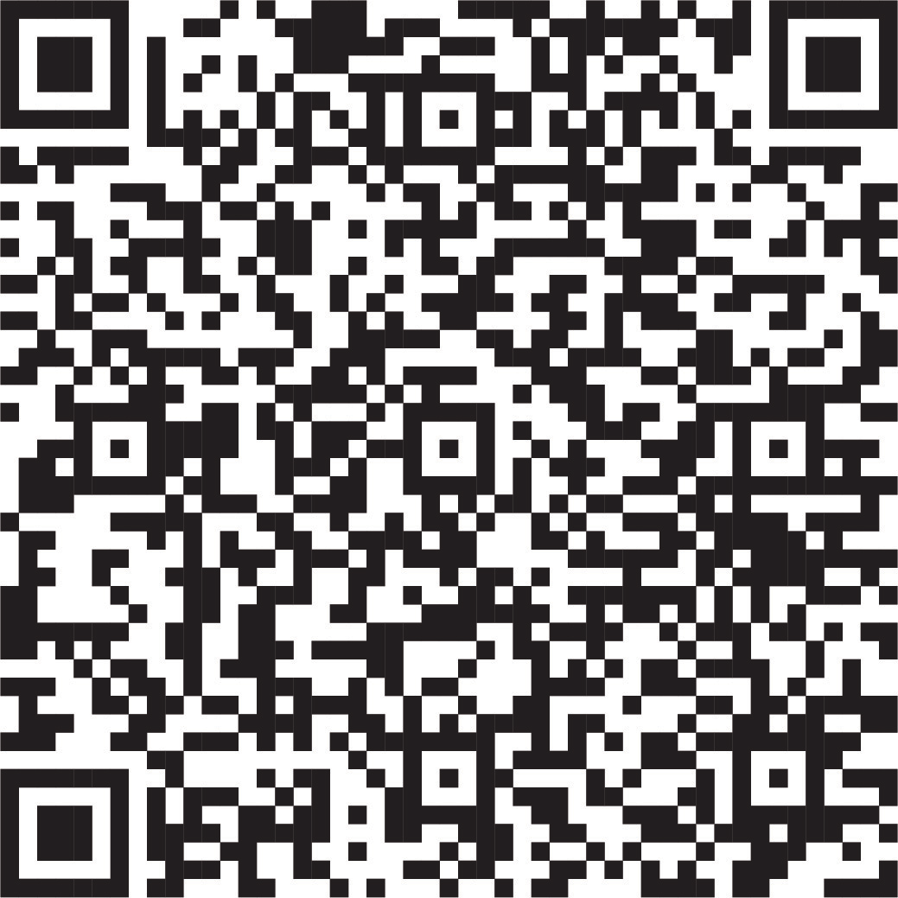


How to take your money to the next level & create a financial legacy
Visit Fidelity.com/BlackLegacy to find on-demand workshops to help you take your money to the next level.
Scan QR code to learn more
Investing involves risk, including risk of loss.
The Fidelity Investments logo is a registered service mark of FMR LLC.
Fidelity Brokerage Services LLC, Member NYSE, SIPC, 900 Salem Street, Smithfield, RI 02917
© 2025 FMR LLC. All rights reserved. 1181863.5.0

